Slide 1
Raster to Vector Conversions in the Case of Uncertainty
Cristobal Guerrero
James Schaffer
Department of Electrical and Computer Engineering, Summer 2012

Slide 2
Objective
-The objective of this project is to convert the results from a random-walk image segmentation to a vector-type data structure while minimizing the error in the region represented
-The image segmentation is probabilistic, so the data is uncertain. Our approach is to take the maximum likelihood fit of a spatial, parametric distribution embedded in a polygonal vector to the segmentation

Slide 3
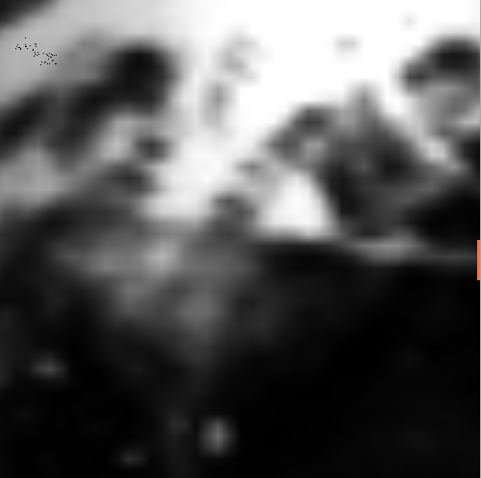
Raster
-In spatial modelling a "raster" (field) is a type of dot matrix data structure that is generally made up of a rectangular grid of pixels

Slide 4

Vector
-In spatial modelling, a "vector" (object) is a type of data structure represented with points, curves, and regions

Slide 5
Motivation
-By doing this conversion the information about the spatially uncertain extent of an astrocyte cell are able to be expressed implicitly rather than explicitly
-Vector representations will have a reduced memory footprint and will speed up some query operations
-The data and models are currently being implemented in the BISQUE system

Slide 6
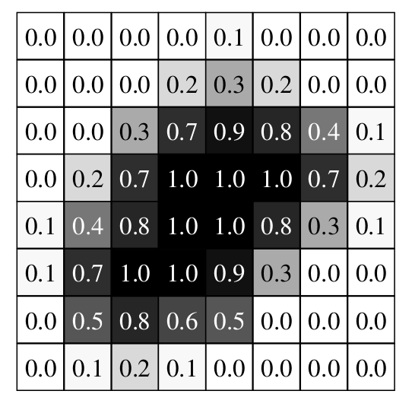
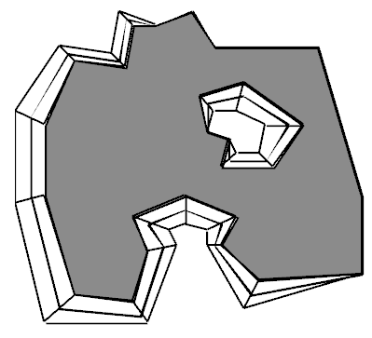
Example

Slide 7
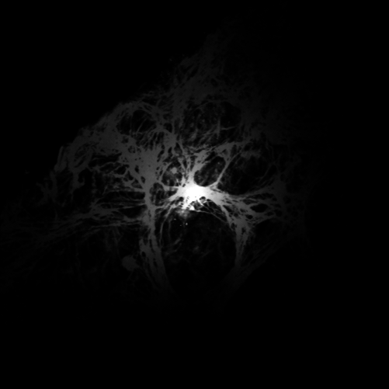
Astrocyte
-An astrocyte is a star-shaped glial cell in the central nervous system
-The astrocytes that were used were stained in order to be visible

Slide 8
Process
- Our approach was based off Erlend Tøssebro's work on uncertain spatial modelling
-This model consists of a support (polygonal face) and a corresponding spatial distribution f(x,y)
- The distribution function of an uncertain face gives a probability value that a given point (x,y) is within the polygon

Slide 9
Uncertain Face
- The vectorized uncertain face consist of the following:
Core
Holes
Support
Outer region

Slide 10
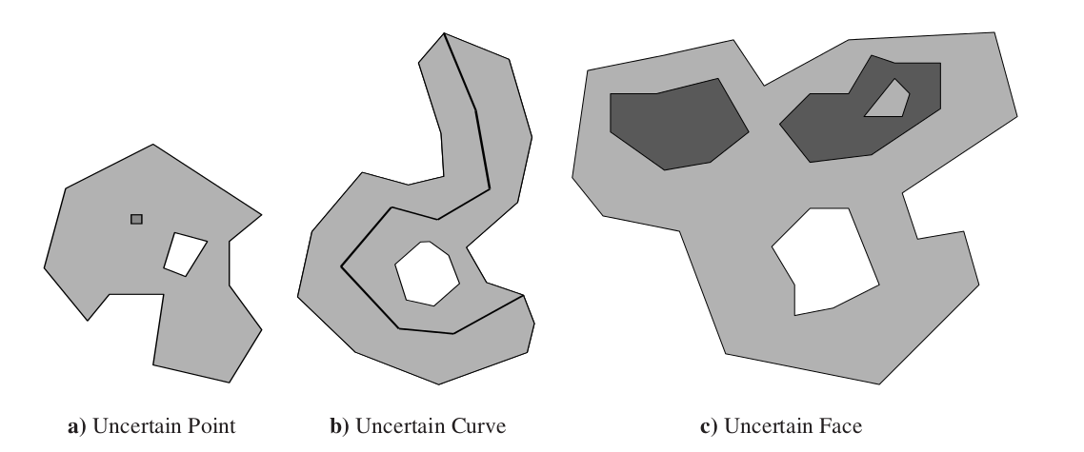
Uncertain Region

Slide 11
Steps Taken
- The first step for the conversion process was to take the original raster image and translate all the pixels to either black or white
-This was done based on pixel intensity

Slide 12
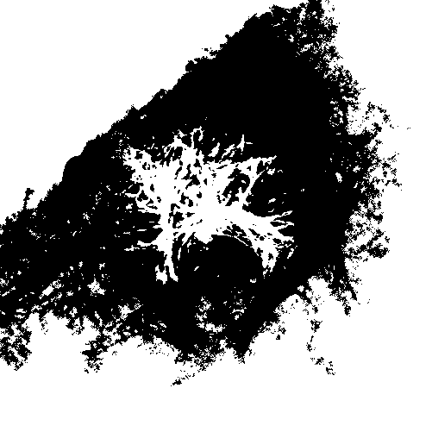
Example

Slide 13
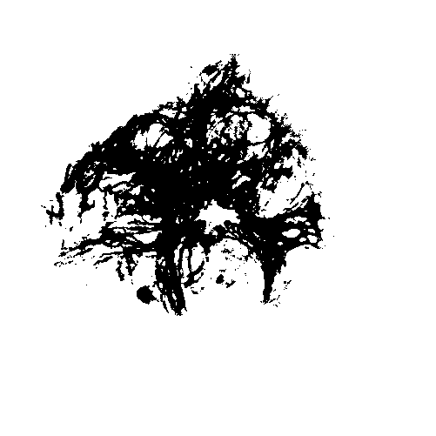
Improved Example

Slide 14
"Vectorizing" the Image
- In order to vectorize the image a function was developed in order to work for any size image
- The corners of the image relative to center of the image or any point that would be determined as the astrocytes center would determine the angle where it had to change the way the image was being traced

Slide 15
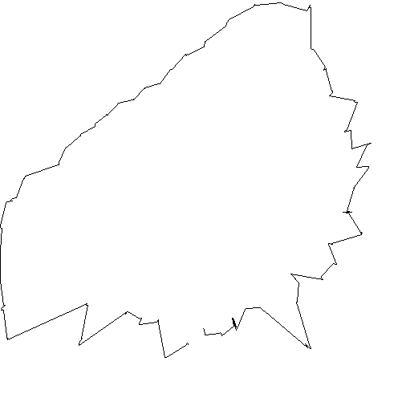
Example

Slide 16
Crisp Converter

Slide 17
Expanding Thresholds
- After having one support region another support was added to see if there was a valid difference in the uncertain region
- The vectorized result was noisier and was not very useful

Slide 18
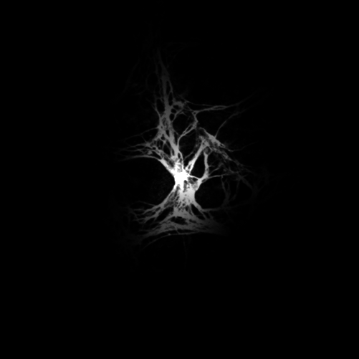
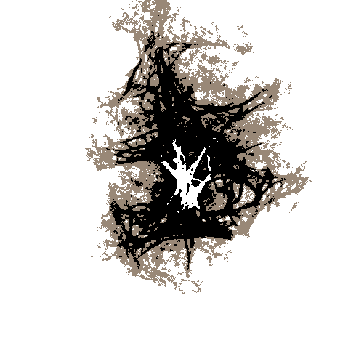
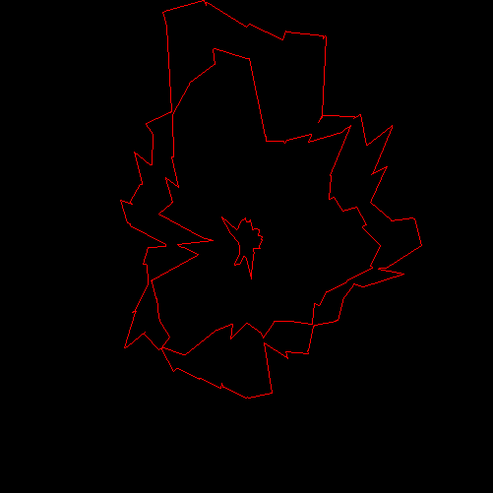
Extra Support

Slide 19
Improving Computational Time
- We came up with several different methods to speed up the computational time for computing different thresholds
- Our first method traced the raster at every point and was later altered to take a point every 10° in order to speed up the computational time taken

Slide 20
Improving Comp. Time Cont.
- After doing various runs with the method of using 10° in order to speed up the computational time other angles were tested though having it at 10° yielded a better visual representation of the raster region

Slide 21
Probability Distribution
- After the support is obtained, we need to represent uncertainty via a probability distribution function along the core to the support
- The probability distribution function can be queried at (x,y) in the support to give a confidence value that the uncertain face intersects that point

Slide 22
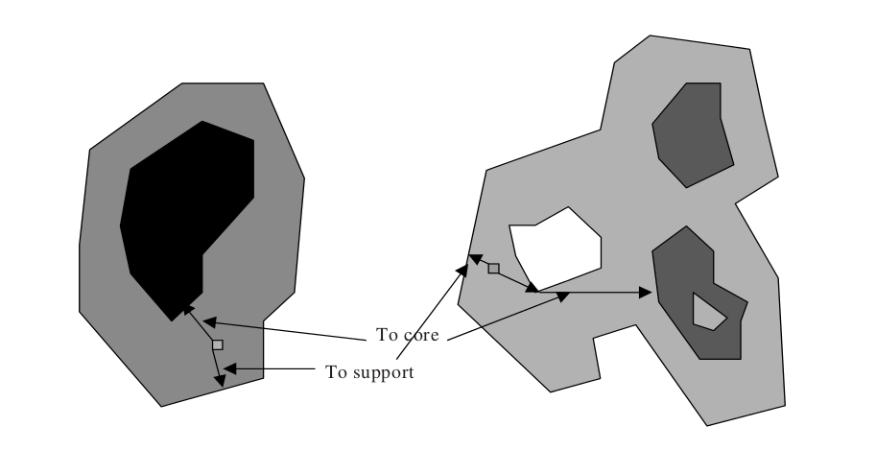
Example
f( x,y in core ) = 1
0 < f( x,y in support ) < 1
f( x,y outside object ) = 0

Slide 23
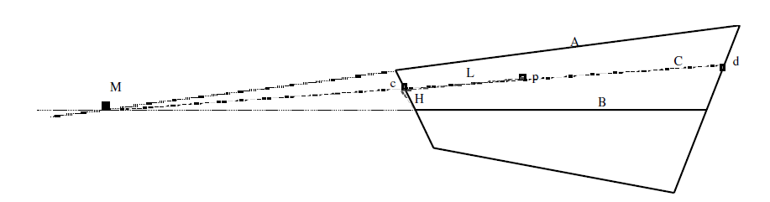
Calculating Probability
-The example above is for calculating the probability when the core of the supported region is not at its center.
-This method uses basic geometry in order to calculate the probability density

Slide 24
Probability Distribution Function
-A simple straightforward method of of calculating the probability is as follows:
P(p) = F(ds/(ds+dc))
ds - distance to support
dc - distance to core

Slide 25
Parameter Fitting
- Once we have a good representation of the support of the astrocyte cell, we need to find the best distribution and parameters to represent the original raster uncertainty
- This can be modelled as a maximum likelihood fit problem

Slide 26
Genetic Algorithm
- A Genetic Algorithm is a search heuristic that mimics natural evolution.
- We want a genetic algorithm to learn what the parameters of the uncertain region should be.
- The genetic algorithm was chosen because:
- the learner is unsupervised
- the algorithm is fairly simple to implement
- our error function (fitness function) is easily parallelizable

Slide 27
Fitness Function
- A fitness function is used to summarize how close a given design solution is to achieving the set aims
-Using a fitness function takes more computational time for training data
- A fitness function can be interpreted as an error function

Slide 28
Calculating Error (Discrete)
-The error calculation checks to see if the probability from the raster is the same as the probability calculated of the vectorized region.
-This is done by encompassing all the points of the raster in a polygon and then checking the probability value at the same point in the vectorized region.

Slide 29
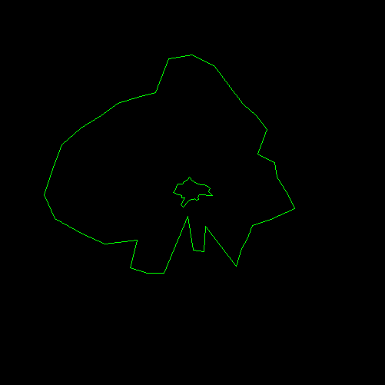
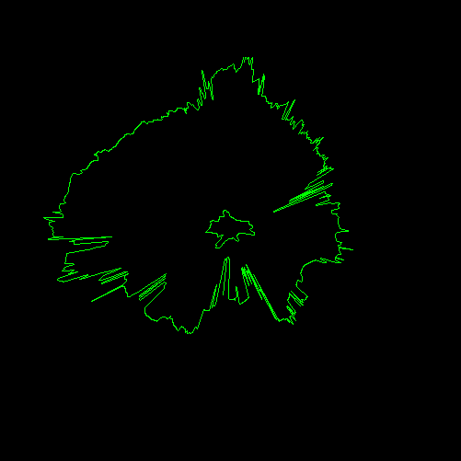
Example

Slide 30
Improving Computation Time
- Taking the original size of the image caused the computational time to be fairly high
- A way to speed up the time was to decrease the image size while keeping the integrity of the original image
- This caused the time to compute the error from about 17 minutes to about less than 3 minutes

Slide 31
Next Week
- The genetic algorithm needs to be implemented and tested
- Our first approach will assume a gaussian and try to find a suitable mean, variance
- Should that fail, we can increase the expressivity of each individual in the GA by having multiple distinct distributions per model and mixing them between cross-curves of the support

